Slide 1
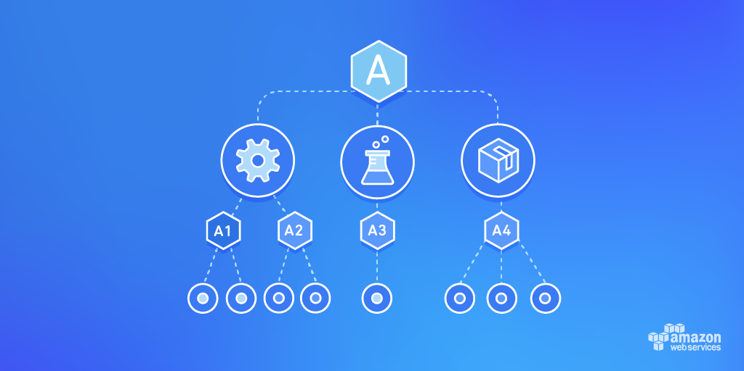
AWS Organizations

Slide 2





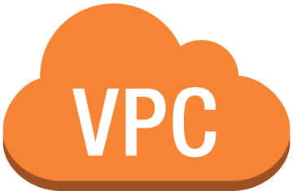


In the beginning…
Prod
Dev-Test
Sandbox
A developer creates an AWS account
A network engineer helps create more VPCs and establishes VPN access
Controls are implemented via roles, policies, tagging, security groups, etc.
Notes:
After Enterprises have focused controls discussions, and with consultation with AWS, a multi-account strategy is born
A Single account becomes at least 2, and then 3 or 4
As part of their education, customers discovered account level features that drove them to create more accounts:
Resource/Application Isolation
Spending Controls
Service Controls
Identity and Access Controls
Networking Controls
Soft and Hard Service Limits

Slide 3







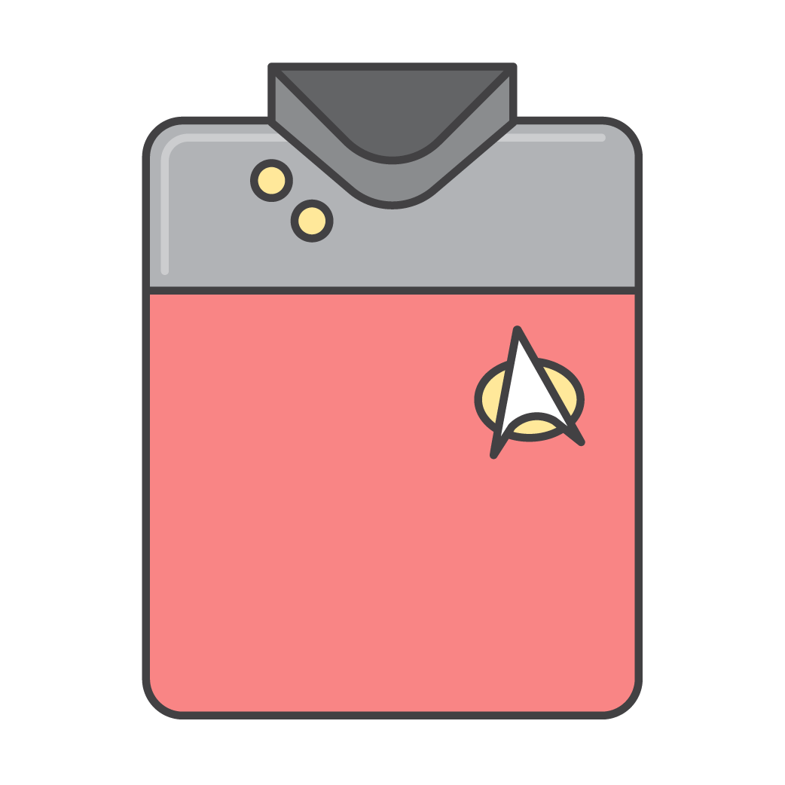
Today – Cloud adoption at scale
Cloud team
Accounts
New controls
US Dev Account
Data Science Account
Centralized policy management
US Prod Account
Shared Service Production
Cross-account deployments &
configurations
US Sandbox Account
Security Account
Data aggregations across accounts
HIPAA-Prod Account
Logging Account
Notes:
As customers increase adoption, the team grows
Customers begin to create more and more accounts with greater specificity
Accounts are commonly segregated by business unit, environment type, IT function, etc.
With a growing number of accounts, several new operational control needs are introduced:
Need to create & manage IAM policies centrally
Need to create various resources (e.g. IAM roles, Policies) or configure various services (e.g. CloudTrail, Config) centrally
Need to aggregate data from services like Config, Inspector, Trusted Advisor across all accounts.

Slide 4
Customer challenges

Slide 5
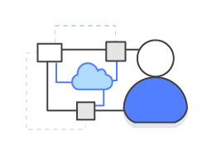


What do enterprise customers need to scale their AWS accounts effectively?
Centrally manage policies across accounts
Easily create new accounts at scale
(for isolation and grouping)
View charges and usage across accounts
Notes:
Customer priorities drive our features and release plans
Four stories have been identified and prioritized by the product teams through numerous voice of customer sessions

Slide 6
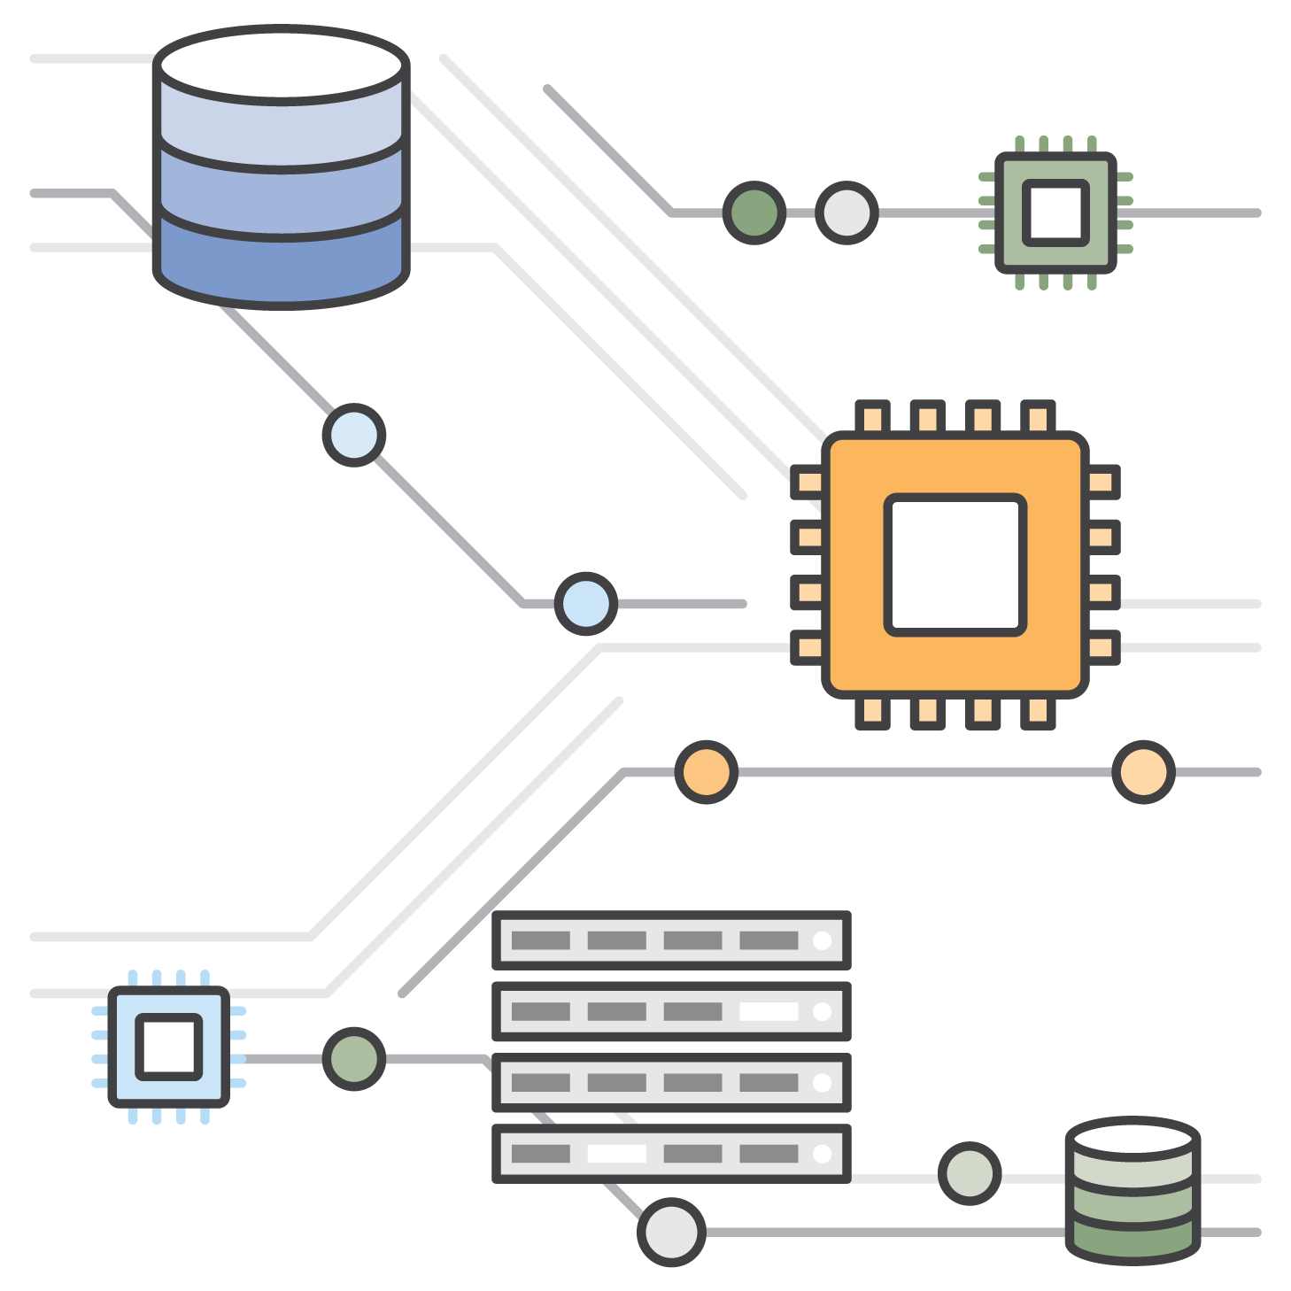



What challenges have customers faced as they increased their number of AWS accounts?
IAM policy replication across accounts requires custom automation
Creating a new account involves many manual processes
Billing consolidation requires manual tasks in multiple accounts
Notes:
Account Creation has historically been a manual process
Policy replication across accounts has required custom scripting
Delegating rights has been very black or white

Slide 7





Introducing AWS Organizations
Policy-based Management for Multiple AWS Accounts
Control AWS service use across accounts
Automate account creation
Consolidate billing and usage reporting
Notes:
These are the three features that AWS Organizations delivers in release 1
Highlight the fact that Consolidated billing happens automatically… no longer are manual tasks required

Slide 8

Typical Use Cases: #1
Control the use of AWS services
Centrally control the use of AWS service APIs across multiple AWS accounts.
Comply with corporate security and compliance policies.
Delegate administration while enforcing centralized guardrails.

Slide 9
Typical Use Cases : #2
Automate the creation of AWS accounts
API driven AWS account creation.
Reduced friction allows for greater account granularity.
Easy hooks to trigger additional automation.

Slide 10
Typical Use Cases : #3
Create different groups of AWS accounts
Group AWS accounts according to purpose.
Organize groups of accounts into a hierarchy.
Apply policies at any point in the hierarchy.

Slide 11
Example
Root
Organization
Root
Master account
Master
BU1_Prod
BU2_Prod
SS_Prod
Member accounts
BU1_Test
BU2_Test
SS_Dev
Organizational unit
BU1_Dev
BU2_Dev
Service control policy
Notes:
Organization – a set of AWS accounts which agree to enter into a relationship in either “billing consolidation” or ”full control” mode.
Root – top-level parent node in the hierarchy of an organization that can contain organizational units (OUs) and accounts
Master Account – The top account in an AWS Organization, to which all member accounts are related. The master account has access to and pays for the consolidated costs of the organization, and can (if enabled) control SCP’s across the Organization and it’s Groups
Member Account – All accounts in an AWS Organization other than the master account are called member accounts
Organizational Unit - a subset of accounts in an AWS Organization, created based on shared attributes
SCP (Service Control Policy) – policy that centrally controls AWS service use across multiple AWS accounts. SCPs put bounds around the permissions that AWS IAM policies can grant to entities in an account, such as IAM users and roles. Entities can only use the services allowed by both the SCP and the IAM policy for the account.
Make this more complex – add a compliance aspect HIPAA
Country

Slide 12


Example
Security
Development
Test
Production
A1
A2
A7
A8
A6
A5
A3
A4
A9

Slide 13
Key Features
Policy framework for multiple AWS accounts.
Control the use of AWS services down to an API level.
Group-based account management.
Account creation and management APIs.
Consolidated billing for all AWS accounts in your organization.
Enable Consolidated Billing Only or All Features.

Slide 14
Service Control Policies (SCPs)
Enables you to control which AWS service APIs are accessible.
Define the list of APIs that are allowed – whitelisting.
Define the list of APIs that must be blocked – blacklisting.
Cannot be overridden by local administrator.
Resultant permission on IAM user/role is the intersection between the SCP and assigned IAM permissions.
Necessary but not sufficient.
IAM policy simulator is SCP aware.

Slide 15
How is Organizations different from IAM?
Create groups of AWS accounts with AWS Organizations.
Use Organizations to attach SCPs to those groups to centrally control AWS service use.
Principals in the AWS accounts can only use the AWS APIs allowed by both the SCP and the AWS IAM policies attached to them.

Slide 16
How to get started?
Revisit or create your account segmentation strategy.
Decide which type of organization is right for you.
Organize your AWS accounts according to it.
Test & begin to apply SCPs slowly.
Iterate on SCPs to achieve your desired state.

Slide 17

The compliance officer
As a compliance officer at a life sciences company, I can control the AWS services available to AWS accounts with HIPAA data so that guidelines based on the BAA are consistently applied.
One SCP is attached to multiple accounts.
Controls are consistently enforced.
Updates to an SCP are automatically applied in real time.
CreateOrganizationalUnit API
CreatePolicy, AttachPolicy, UpdatePolicy APIs
Notes:
These are too busy, too much text … clean them up

Slide 18
The IT operations manager
As an IT operations manager, I can create development, test, and production OUs so that service API controls based on company IT policies are consistently applied.
Accounts can be grouped into an OU.
It’s easier to manage a single policy attached to an OU.
CreateOrganizationalUnit API
CreatePolicy, AttachPolicy, UpdatePolicy APIs
Notes:
These are too busy, too much text … clean them up

Slide 19
The development team
As a development team, we quickly get access to dedicated AWS accounts with the correct corporate controls so that resources are isolated and product development timelines are maintained.
Scripted account creation.
Automatic account enrollment in consolidated billing.
Accounts added to an OU inherit the SCP attached to the OU.
CreateAccount API
MoveAccount API
Notes:
These are too busy, too much text … clean them up

Slide 20
Blacklisting example
Whitelisting example
{
"Version": "2012-10-17",
"Statement": [{
"Effect": "Allow",
"Action": "*",
"Resource": "*"
},
{
"Effect": "Deny",
"Action": "redshift:*",
"Resource": "*"
}
]
}
{
"Version": "2012-10-17",
"Statement": [{
"Effect": "Allow",
"Action": [
"ec2:RunInstances",
"ec2:DescribeInstances",
"ec2:DescribeImages",
"ec2:DescribeKeyPairs",
"ec2:DescribeVpcs",
"ec2:DescribeSubnets",
"ec2:DescribeSecurityGroups"
],
"Resource": "*"
}
]
}

Slide 21
Pricing & Availability
Available at no additional charge.
Global service.
Accessed through endpoint in N. Virginia region.

Slide 22
Questions?

Slide 23
Backup Slides

Slide 24

SCPs are necessary but not sufficient
SCP
IAM
Permissions
Allow: EC2:*
Allow: EC2:*
Allow: S3:*
Allow: EC2:*
Allow: SQS:*

Slide 25
Best practices – AWS Organizations
Monitor activity in the master account using CloudTrail.
Do not manage resources in the master account.
Manage your organization using the principal of “Least privilege.”
Use OUs to assign controls.
Test controls on single AWS account first.
Only assign controls to root of organization if necessary.
Avoid mixing “whitelisting” and “blacklisting” SCPs in organization.
Create new AWS accounts for the right reasons.

Slide 26
Amazonians: Please provide feedback on this content. Demo content available here.

